Slide 1

NYPD NYC Crime data analysis
Team Members:
Harshal Bendale
KUNAL JOSHI
MURIEL BANZE

Slide 2

Table of Contents
Introduction
Data Exploration
Methodology
Data Pre-processing
Mining the Data
Model Performance
Logic of Problem
Conclusion
Tableau

Slide 3

Introduction
Problem description:
Security and life safety are important aspects while making decisions regarding selection of place for residence, education or work.
Various sources are available to provide about safety of a region but might not provide enough/reliable information that we need.
The problem we are analysing is to find out the severity of crimes in a region which can help people in their decision making about their place of choice
Motivation:
Crimes cannot be predicted since it’s not systematic or random in nature. The advancements in technologies and specialized methods of utilizing these technologies have enabled individuals in conducting crimes in various geographic areas.

Slide 4
Data exploration
Source:
The NYPD arrests dataset ranging from 2012-2017 years is taken from the NYC OpenData website which is provided by the Police Department (NYPD).
The dataset contains 4.85 million recorded crimes, with 18 columns each containing details of the crime.
Following interesting observations were made:
Highest recorded crimes observed are in Kings (1334914) followed by Manhattan (1303786), Queens (895903), Bronx (1097367) and the least in Staten Island (166361).
Bronx had the highest crimes for dangerous drugs (1056378) as well as most crimes committed in the age group of 25-44.
Males have significantly higher crimes (3996247) compared to females (802092).
Link to the dataset: https://data.cityofnewyork.us/Public-Safety/NYPD-Arrests-Data-Historic-/8h9b-rp9u

Slide 5


Methodology
Data Pre-processing
The first step towards data pre-processing was to trim the dataset which consisted of nearly 4.8 million records. The dataset was trimmed by implementing on python that separated each record based on the year.
Simple random sampling was used to select values from the dataset with approximately 31000 records. Principal Component Analysis (PCA) was used to rank elements and later unwanted attributes were eliminated.
The algorithms that are being implemented are done by using Classification and Association Rule Mining techniques.
The main focus is to find the outcome of the class values such as AGE_GROUP, PERP_SEX, PERP_RACE, and ARREST_BORO. These class values consist of data that will provide useful insights while developing the model and testing against it.
Mining the data

Slide 6
Classification Algorithms
Naïve Bayes classifier | J48 | Bagging | K-Nearest Neighbour
The assumption made in this classifier is that features are independent, hence called naive. In this dataset, features such as OFNS_DESC, ARREST_BORO, AGE_GROUP, PERP_SEX, PERP_RACE are independent. | Decision trees are based on splitting criteria in which instances are classified according to their feature values. A leaf node symbolizes a class label. J48 is well known for good accuracy and high precision | It is an ensemble meta-estimator which gives prediction either by voting or averaging by introduction of randomization into its construction procedure and then making an ensemble out of it. | The number of nearest neighbours is the decision factor for classification. Closest similar points are found by using Euclidean distance and then vote for class labels take place. Since our dataset has only 10 features and KNN works better with a lower number of features than a large number of features, so we chose this with a value of K as 1.

Slide 7
Test and train data accuracy
Training dataset accuracy:
Test dataset accuracy:
Algorithm | AGE_GROUP | PERP_SEX | PERP_RACE | ARREST_BORO
Naive Bayes | 44.25% | 73.99% | 42.27 % | 33.18%
Lazy IBK | 53.94 % | 82.44 % | 53.71 % | 41.54%
Bagging | 54.09 % | 82.59 % | 54.22 % | 42.29%
J48 | 54.05 % | 82.47 % | 53.97 % | 41.98%
Algorithm | AGE_GROUP | PERP_SEX | PERP_RACE | ARREST_BORO
Naive Bayes | 39.53 % | 55.81 % | 38.61 % | 32.94%
Lazy IBK | 54.09 % | 55.81 % | 51.49 % | 41.18%
Bagging | 47.67 % | 56.98 % | 46.53 % | 42.35%
J48 | 47.67 % | 56.98 % | 49.51 % | 38.82%

Slide 8
Association Rule Mining using Apriori:
The Apriori algorithm iteratively reduces the minimum support so that the required number of rules are obtained with the given minimum value of confidence.
This algorithm was used mainly to find the relationship between attributes to obtain frequent items sets that mainly provide the following information such as:
1. Age and Gender that dominated in committing crimes for that particular county
2. County with the most recorded criminal activity.
3. Offense committed based on race and gender

Slide 9
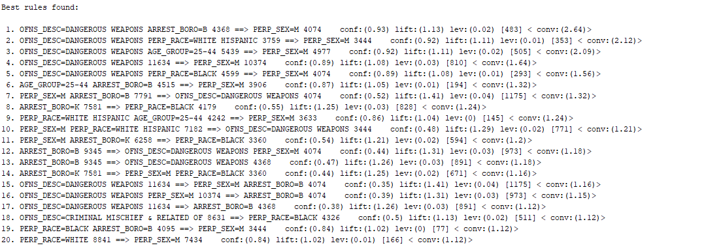
The Apriori algorithm is bound by lowerBoundMinSupport of 0.1 to upperBoundMinSupport 1.0. This algorithm finds all the rules between these bounds with certain increments of delta value of 0.05.
The metricType was set to Conviction to rank the results
minMetric: 1.1 (default)
numRules: 20
Fig [1] Screenshot of the best rules using Apriori algorithm

Slide 10
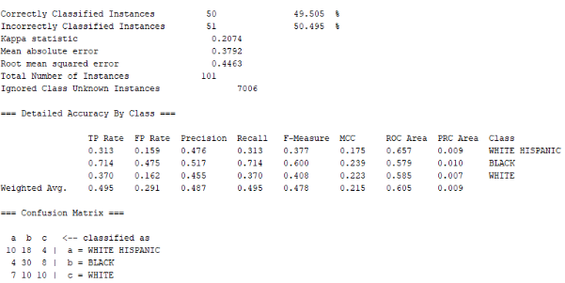

Models performance
For the performance measurement of the models, various measures were considered such as correctly classified Instances, AUC i.e, Area Under Curve, ROC i.e., Receiver Operating Characteristics, Precision, Recall, Confusion Matrix.
In this project, 10 fold cross-validation was used while training the models with approximately 31000 records. So, in this approach out of 10 samples, 9 were used for training and 1 was used for testing. Plus we used a separate test dataset comprising about 7000 records, to check the performance of the models created.
Fig [1] Screenshot of the classification of Perp_Race using J48 algorithm using testing dataset

Slide 11
Logic of problem
We are keen on finding areas that are prone to crime and we use the critical thinking approach for better analysis of issues.
Pros of analytical thinking procedure:
Analytical Thinking leads us to abandon non-adaptive beliefs.
It expands the knowledge base since it requires knowing reasons and every aspect of the problem.
Cons of analytical thinking procedure:
It is a more time consuming procedure since it involves thinking to more depth about some problem.
The standards that the model uses to evaluate elements in Logic of the problem, Complexity standard can be added. While evaluating elements, complexity standards play an important role. Other standards such as Clarity, Accuracy, Precision are very much related to the Complexity of the problem.

Slide 12
Conclusion
For classification, J48 and bagging algorithms gave best accuracy along with good ROC and precision.
Since, the dataset was skewed for PERP_SEX with more number of Male values, so in this case False Positive rate was more in all classification. Also in the case of PERP_AGE based classification, the dataset was skewed with more number of instances for the age group of 25-44. In this case False Positive rate was more as well.
Similarly ARREST_BORO had lower accuracy with good ROC value and less false positives. And PERP_RACE based classification, had average 50 percent accuracy for each classifier with good ROC values. However, False Positive rate of Black class instances were high.
In summary, due to the skewed dataset we faced issues in classification of PERP_SEX and PERP_RACE based classification. We tried to solve these issues by doing under sampling to make the dataset balanced. Following this we got better accuracies with less False Positive rates.
Association Rule mining provided values which gave items sets pointing towards male indicating most of the crimes were committed by this gender.
In this project, our main focus was on classification and association algorithms. In the future, we would like to implement clustering techniques to make clusters according to the severity of crimes in various areas.

Slide 13

Thank you!
Flora@contoso.com
http://www.contoso.com/

